Slide 1

CAPSTONE PROJECT
(TWITTER US AIRLINE SENTIMENTS)
INSTRUCTOR: PROF.SAVITA SEHRAWAT
SUBMITTED BY: Ravinderjit Kaur(0763523)

Slide 2
INTRODUCTION
In this study, natural language processing sentiment analysis for the Twitter US airline dataset is carried out. The text field in the dataset was divided into positive, negative, and neutral sentiment polarity. Sentiment analysis, often known as opinion analysis, is a machine learning method that airline services now extensively use to gauge client sentiment or the general consensus regarding their offerings in social media language. The airline support staff is focused on analysing social media content from blogs, online forums, comments, and reviews. This evaluation is being abused to form opinions or measure how well their services are performing.
The input data to the classification model must be closed using classification procedures in order to train the data. For the newly learned data, these models forecast the class label categories.

Slide 3
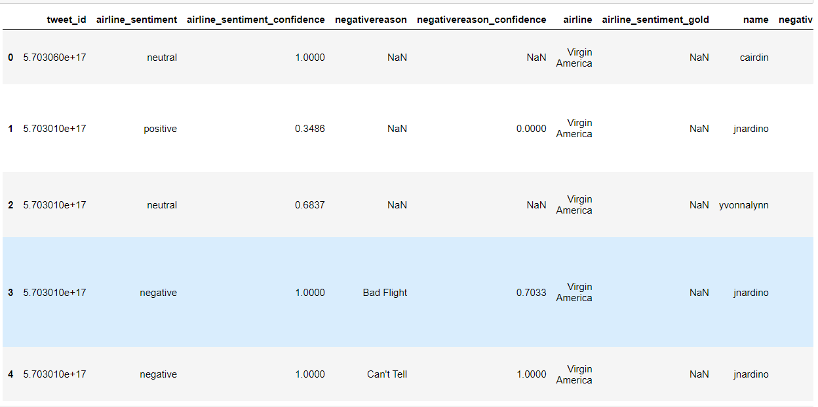
DATASET INFORMATION:
The dataset I have chosen has 14640 records and 15 attributes. It has these columns

Slide 4
ABSTRACT
The dataset contains details about the tweet shared by customers about different US airlines which are virgin America, United Airlines, US airways, American airways, South West Airways and Delta airways. It contains data from the year 2015 and it has also people’s opinion and sentiments related to respective airlines.
This work can be useful for the airline company to understand what are the problems to working on.
RESEARCH QUESTIONS:
• Which flights received which kind of favourable or unfavourable tweets, and about which services, will assist to sustain or change the service in accordance with customer emotion.
• Which complaints about poor treatment on aeroplanes are most frequently tweeted by passengers.
• Determine whether planes had more favourable or bad tweets, then classify the latter according to the source.
• Does flight time have an impact on service quality?

Slide 5
LITERATURE REVIEW:
The authors of "A Text Mining Application of Emotion Classifications of Twitter's Users Using Naive Bayes Method," Liza Wikarsa and Sherly Novianti Thahir, developed a classification model to sort the text in tweets according on sentiment polarities. The test studies shown that specific phrases and a larger training dataset obtained a greater accuracy for the identification of emotions because they may provide a better and wider coverage of the emotional situations in our daily lives. In their article "Opinion Mining of Twitter Data for Recommending Airlines Services," Pranika Jindala, Varun Jaiswala, and M. Umac examined various classification models with measures of sentiment analysis and found that the new ensemble ada boost approach had the highest accuracy value. They desire to use these models in several languages and also needs client data to add or modify the current functionality. The authors of "Tweet sentiment analysis with classifier ensembles," Nadia F.F. da Silva, Eduardo R. Hruschka, and Estevam R. Hruschka, employed ensemble classification methodologies for several classification models and compared the accuracy of the ensemble classification models. They solely exploited the polarities of positive and negative sentiment. They will apply the classification models to different datasets that are neutral in terms of sentiment.

Slide 6
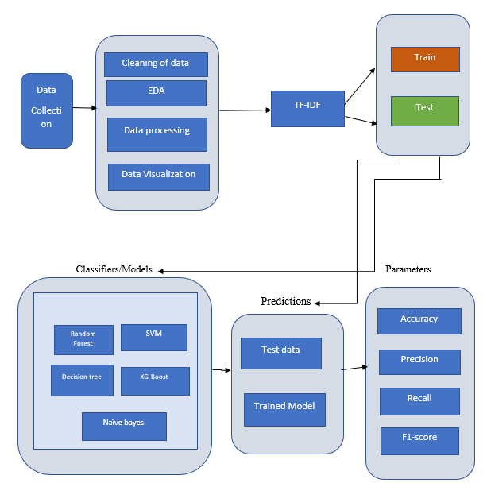
METHODOLGY:

Slide 7
Overall methodology explained in brief:
Step1: The dataset used in this study, dubbed "Twitter US Airline Sentiment," has 15 columns and a total of 14,640 tweets. Six of the main US Airlines were represented by the tweets gathered from Twitter in February 2015: United, US Airways, Southwest, Delta, and Virgin America. The tweets included a mix of positive, negative, and neutral feelings,
Step2: Punctuation was taken out of the data because it wasn't necessary for the study's text analysis. Although punctuation makes sentences more readable, it makes it harder for models to distinguish between punctuation and other letters. The tweets' numerical values were eliminated in the following stage because they had no bearing on text analysis. deleting numbers from values decreases the complexity of training the models.
Step3: The corpus was split into a "training subset" and a "testing subset" following the pre-processing stage. For training and testing, it was split in a 3:1 ratio, respectively. The training subset was then subjected to feature extraction techniques, as depicted in Figure 6, which illustrates the employed methodology. Both the training data used to develop the selected models and the testing data used for classification both underwent feature extraction techniques.
Step4: TF-IDF: A common scoring method in information retrieval (IR) and summarization is TF-IDF. The goal of TF-IDF is to demonstrate how pertinent a phrase is in a particular document. TF-IDF feature extraction takes both TF and IDF into account. IDF awards tokens that are uncommon across the board in a dataset. (term frequency (TF), inverse document frequency (IDF)).
Step 5: Next, in this section compared bagging classifiers and non-bagging classification techniques. The classification techniques are: Random Forest Classification, Naive Bayes , Support Vector Machine, Decision Trees , Extreme Gradient Boosting (XGB).

Slide 8
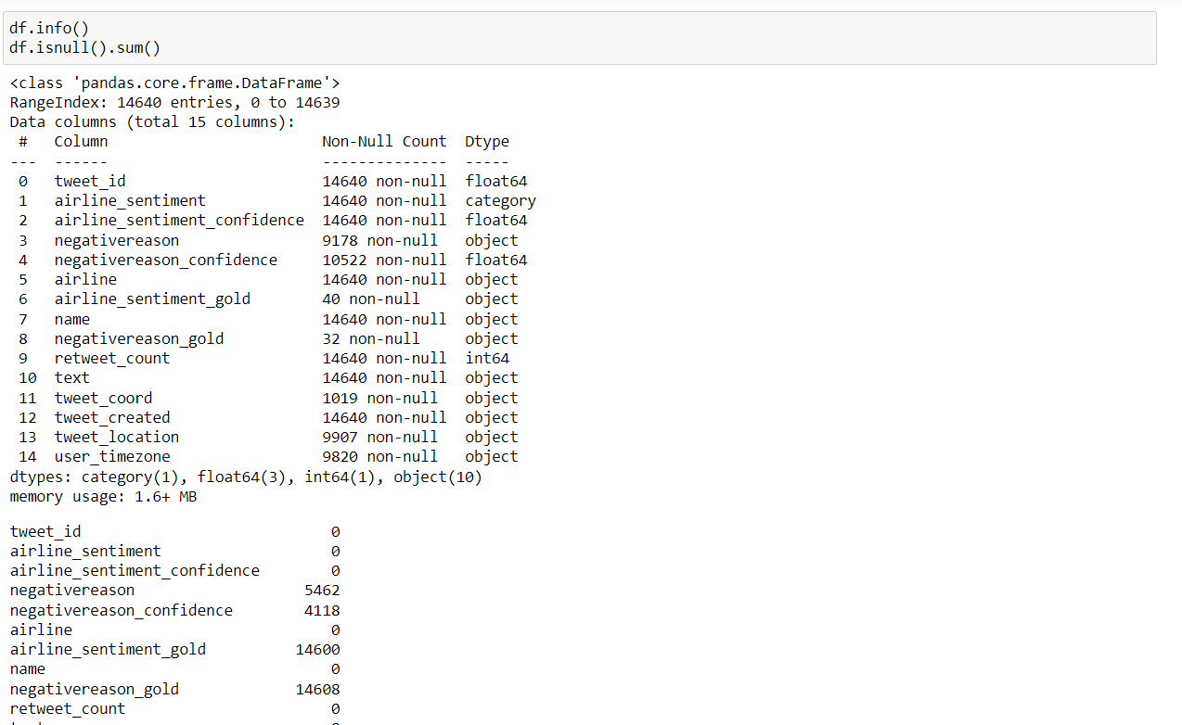
DATA MANIPULATION:
Changing data type.
Checking null values.
Checking shape f the data
Checking Data Duplicacy.

Slide 9
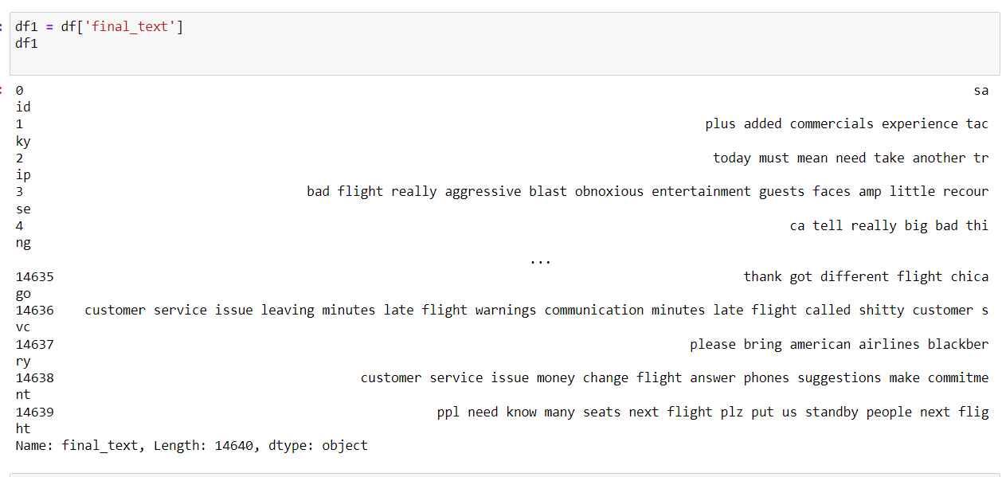
DATA PRE-PROCESSING:
Partial Pre-processing:
Changing the datatype of attribute
Replacement of null values.
Complete Pre-processing:
Removing stop words
Removing punctuations

Slide 10
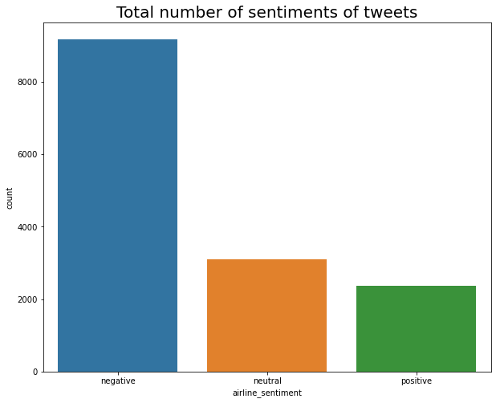
DATA VISUALIZATION:
Total number of sentiments of tweets negative 9178neutral 3099positive 2363negative
This graph depicts the total number of tweets in a whole dataset and also describing the count of tweets in accordance with negative, neutral and positive.

Slide 11
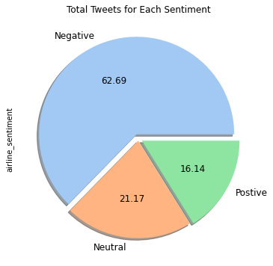
Figure 3: Total Number of Sentiments of Tweets with Percentage
The given bar-graph delineates the info about sentiments of the tweet and the percentage of tweets as from this graph, we can make conclusion that most of tweets are negative with 62.69%.

Slide 12
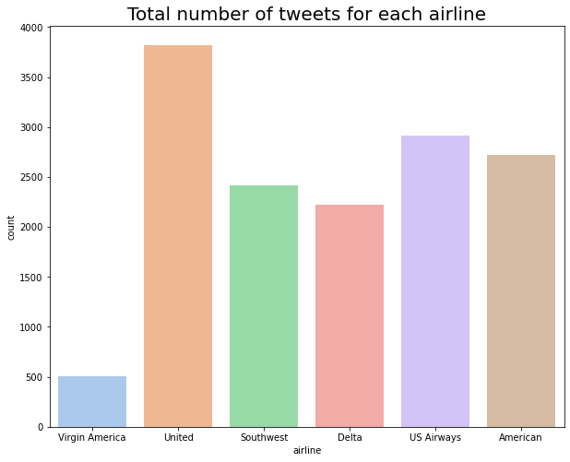
Figure 5: Total Number of tweets for each airline
Total number of sentiment tweets for each airline :US Airways : negative 2263neutral 381positive 269United : negative 2633neutral 697positive 492This figure, tells about the negative tweets of each airline as well as count of positive, negative and neutral tweets. For example, US Airways has 2263-negative, 381-neutral and 269-positive

Slide 13
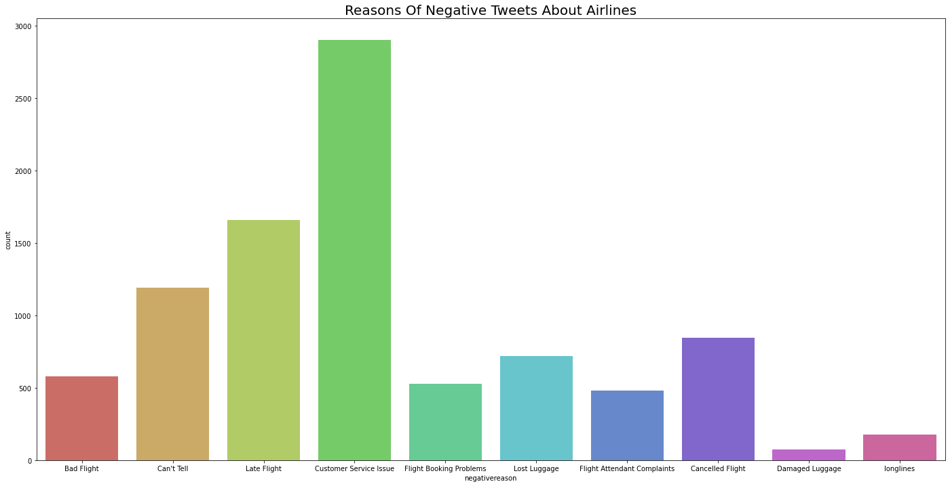
Figure 6: Reasons of Negative Tweets about airlines
Post that, this graph tells us about the reasons of negative tweets either it is customer service issue, bad flight, late flight etcetera. Most of tweets are about customer service issue.

Slide 14
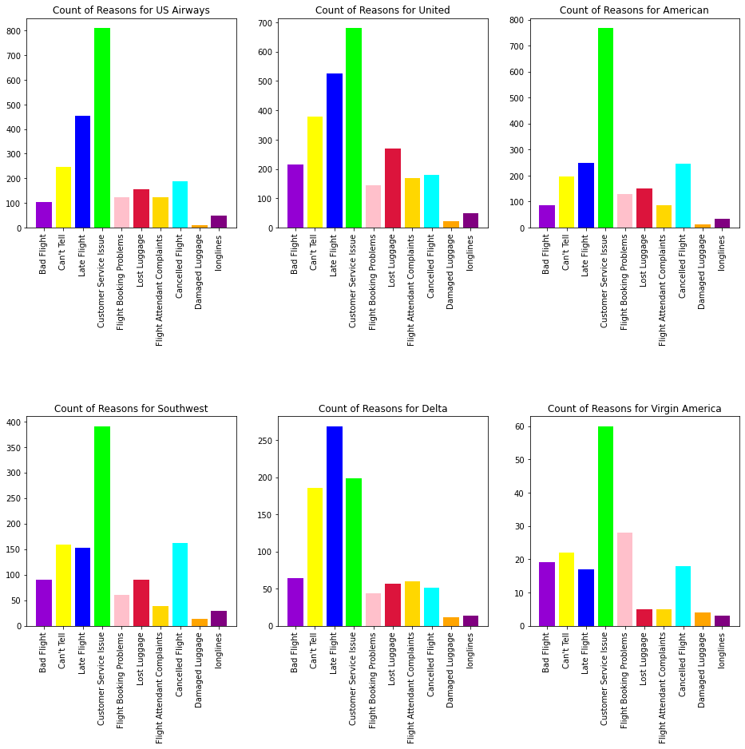

Slide 15
MODELLING METHODS:
TF-IDF: A common scoring method in information retrieval (IR) and summarization is TF-IDF. The goal of TF-IDF is to demonstrate how pertinent a phrase is in a particular document.
Train and Test Split: The corpus was split into a "training subset" and a "testing subset" following the pre-processing stage. For training and testing, it was split in a 3:1 ratio, respectively.
The classification techniques are
Random Forest Classification
Naive Bayes
Support Vector Machine
Decision Trees
Extreme Gradient Boosting (XGB)

Slide 16
Random Forest Classification: Random Forest Classification This classifier, a meta-estimator, fits a number of decision trees to various dataset samples. The model classifier's predictive accuracy is developed using the average, and over-fitting is prevented.
Naive Bayes: Naive Bayes classification is based on the Bayes theorem and takes the confidence between each pair of features into consideration.
Support Vector Machine: This machine learning classification algorithm is under supervision. It is a visual representation ;of the training data points that have been divided into groups.
Decision Tree: Using a decision tree approach, one can build complex trees and make changes to the data to produce radically different results.
Gradient Boosting: Collaborative Classification Approach for Airline Tweets Using Extreme Gradient Boosting XGB.

Slide 17
Models | Accuracy | Precision | F1- score
Random Forest Classification | 0.9529 | 0.98 | 0.99
Naïve Bayes | 0.8593 | 0.90 | 0.92
SVM | 0.83651 | 0.92 | 0.91
Decision Tree Classifier | 0.9417 | 0.93 | 0.96
XG-Boost | 0.8720 | 0.89 | 0.90
TABLE OF PARAMETERS

Slide 18
 | precision | Recall | F1-score | Support
Negative | 0.98 | 1.00 | 0.99 | 2343
Neutral | 0.94 | 0.94 | 0.94 | 2264
Positive | 0.95 | 0.94 | 0.94 | 2277
Accuracy |  |  | 0.96 | 6884
Macro average | 0.96 | 0.96 | 0.96 | 6884
Weighted average | 0.96 | 0.96 | 0.96 | 6884
CLASSIFICATION REPORT OF RANDOM FOREST

Slide 19
CONCLUSION:
To conclude the whole survey or project, as my dataset is “US Airline Twitter Sentiments”, as the name described that its about the sentiments of the people regarding their experience while travelling in the flights. The dataset contains 14640 records and 15 attributes from which have dropped some attributes and changed the datatype according to the need as well as replaced the null values. Post this, by removing stop-words and punctuations from the ‘text’ attribute, all in all text pre-processing or text-analysis is done based on the requirement. Then, to normalize the data TF-IDF vectorizer is used and for handling imbalance SMOTE is used.
Post that, data visualization is also done based on the research papers studied. Word cloud about the negative, neutral and positive is described as well.

Slide 20
In terms of research questions, the findings are:
Most of the flights got negative tweets about the customer service issue. So, they have to focus on this issue while, the least filed issue is damaged luggage.
Most tweeted complaints are about Customer Service issue.
Mostly flights had negative tweets which I had classify all the issues using visualization.
So, last but not least few methodologies are used as random forest classifier, decision tree, SVM etcetera to find the best model to predict the future. In accordance with accuracy the best fit model is “Random Forest” with 96% accuracy.

Slide 21
THANKS

